Slide 2
2023-2024 SDRC Performance Report

Slide 3
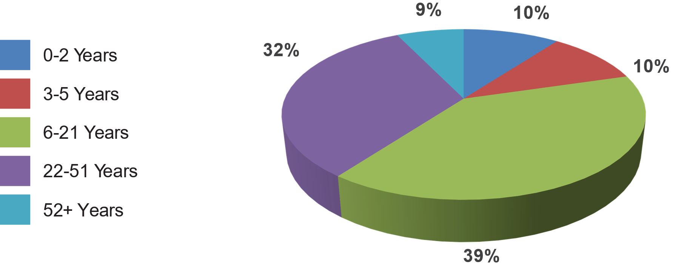
Age of Clients

Slide 4
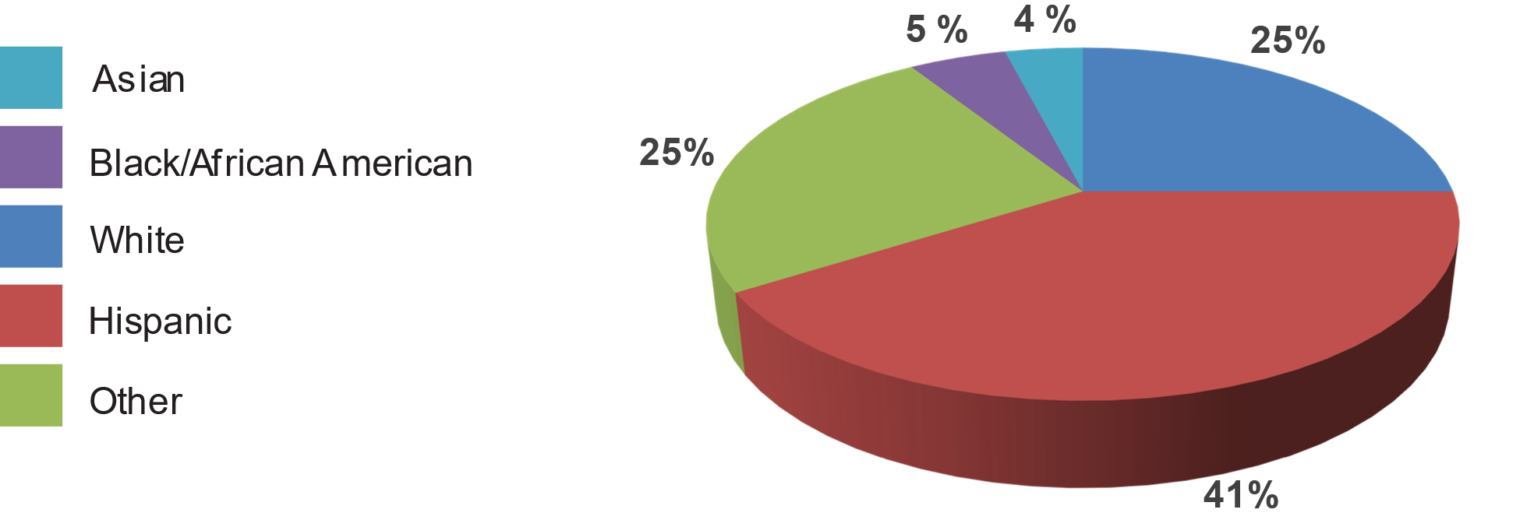
Ethnicity of Clients

Slide 5
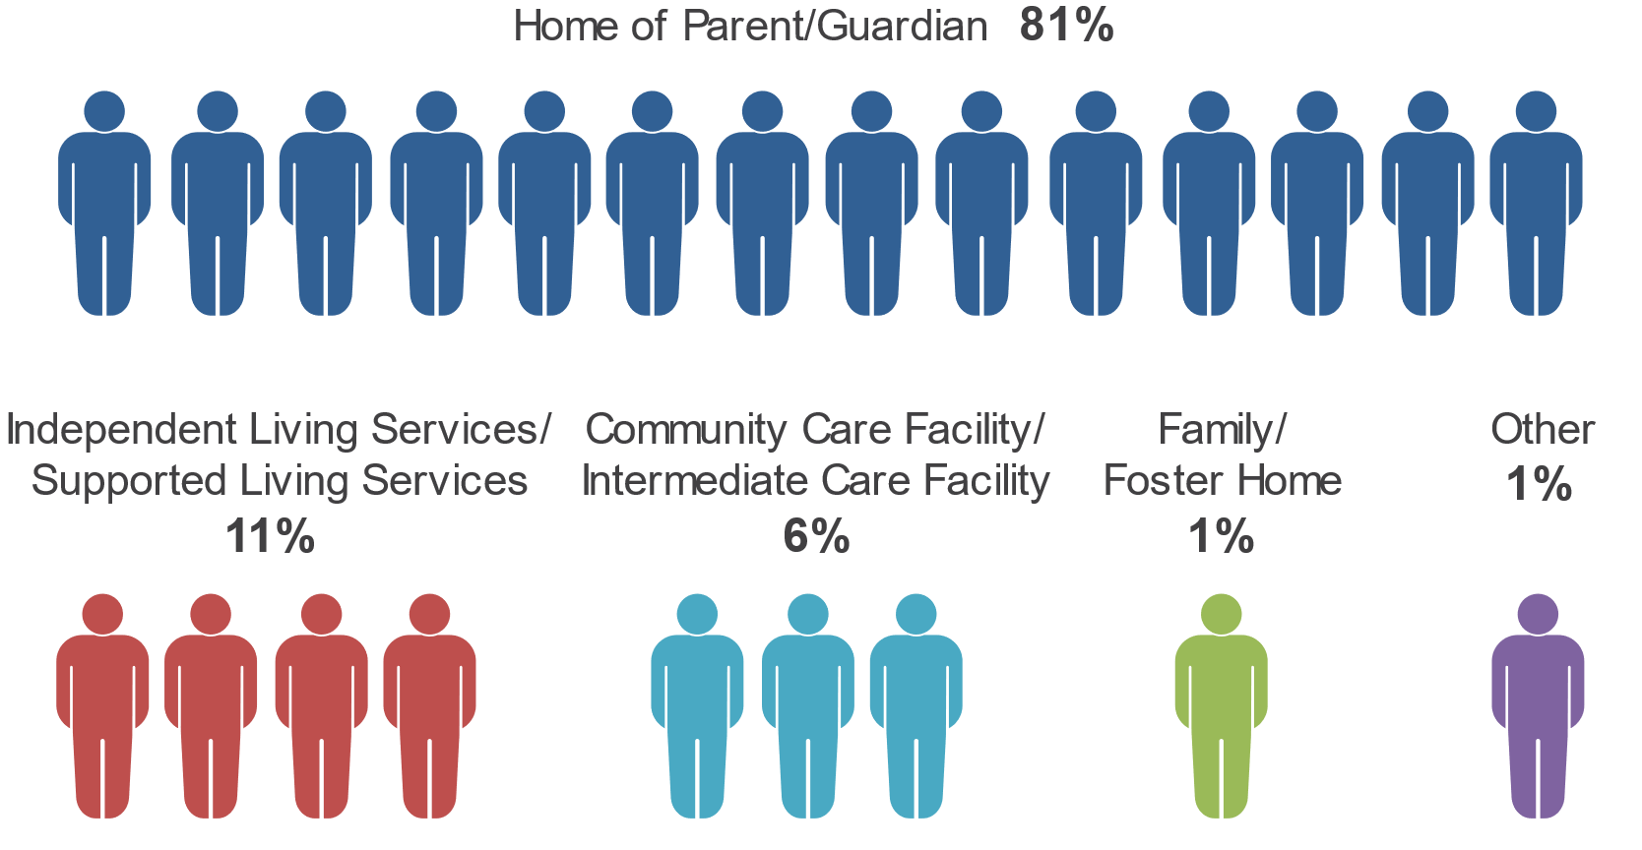
Where Do Clients Live?

Slide 6
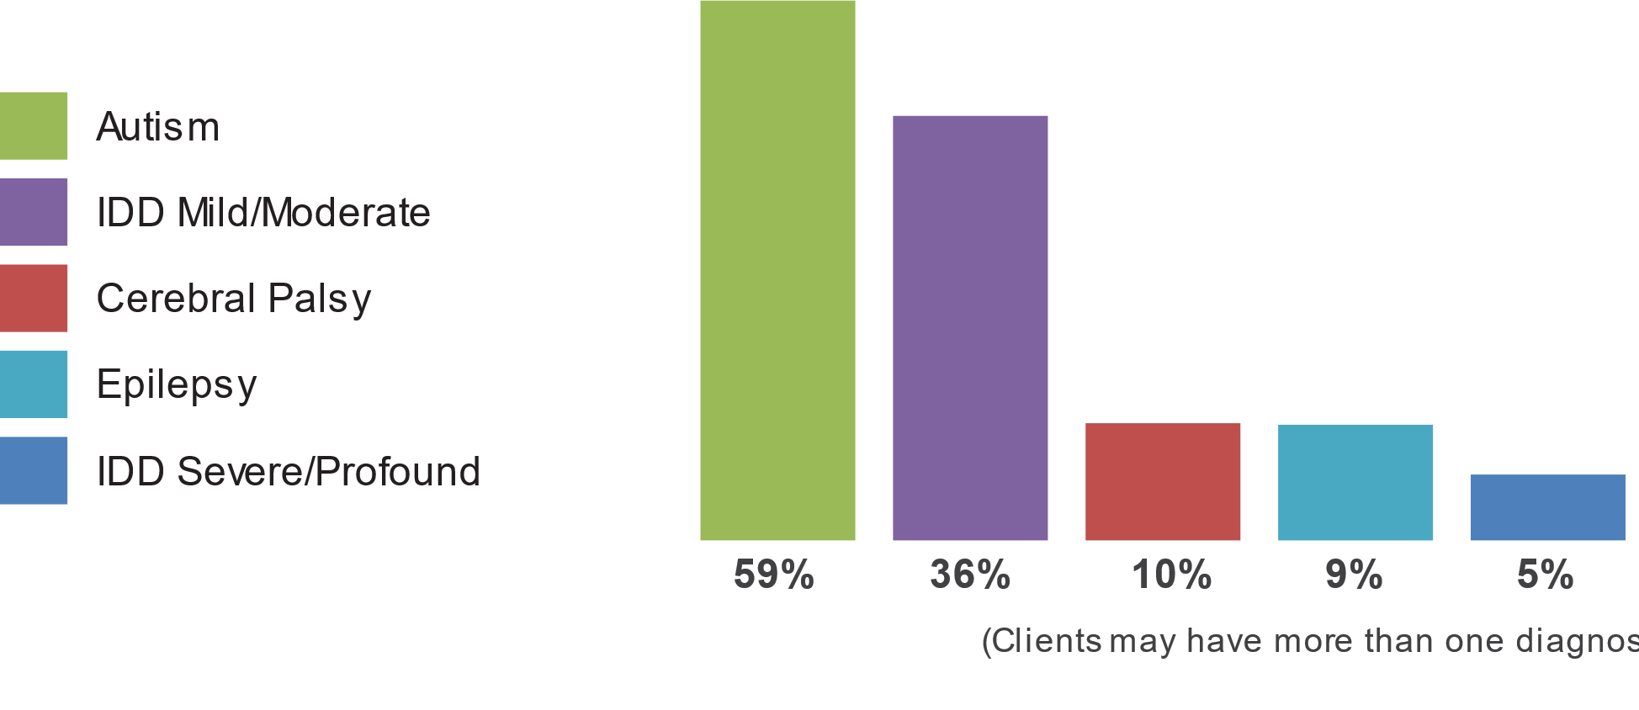
Diagnosis of Clients

Slide 7
How Well is SDRC Performing?
Regional Center Goals (based on Lanterman Act) | Last Reporting Period (December 2022) |  | Current Reporting Period (June 2024)
 | State Average | SDRC | State Average | SDRC
Fewer consumers live in developmental centers | 0.06% | 0.05% | 0.05% | 0.05%
More children live with families | 99.61% | 99.56% | 99.69% | 99.56%
More adults live in home settings | 83.01% | 81.28% | 83.86% | 82.15%
Fewer children live in large facilities (more than 6 people) | 0.03% | 0.07% | 0.02% | 0.03%
Fewer adults live in large facilities (more than 6 people) | 1.67% | 1.80% | 1.46% | 1.68%

Slide 8
Did SDRC Meet DDS Standards?
Areas Measured | Last Period | Current Period
Passes independent audit | Yes | Not Met
Passes DDS audit | Yes | Yes
Audits vendors as required | Met | Met
Didn’t overspend operations budget | Yes | Yes
Participates in the federal waiver | Yes | Yes
CDERs and ESRs are updated as required (CDER is the Client Development Evaluation Report and ESR is the Early Start Report. Both contain information about consumers, including diagnosis.) | 96.81% | 99.86%
Intake/Assessment timelines for consumers age 3 or older met | 91.81% | 80.65%
IPP (Individual Program Plan) requirements met | 99.46% | 98.43%
IFSP (Individualized Family Service Plan) requirements met | 96.4% | 93.2%

Slide 9
How Well Is SDRC Doing At Getting Consumers Working?
Areas Measured | Time Period
 | CA | SDRC | CA | SDRC
Consumer Earned Income ( Age 16 to 64 years): Data Source: Employment Development Department | Jan through Dec 2022 |  | Jan through Dec 2023
Quarterly number of consumers with earned income | 31,413 | 3,118 | 32,132 | 3,260
Percentage of consumers with earned income | 15.40% | 18.24% | 15.20% | 18.24%
Average annual wages | $13,198 | $12,390 | $14,251 | $13,072
Annual earnings of consumers compared to people with all disabilities in California Data Source: American Community Survey, 2022 five-year estimate | 2021 |  | 2022
 | $30,783 |  | $29,382
National Core Indicator Adult In-Person Survey* | July 2017-June 2018 |  | July 2020-June 2021
Percentage of adults who reported having integrated employment as a goal in their IPP | 29% | 31% | 35% | N/A

Slide 10
How Well Is SDRC Doing…continued
Areas Measured |  |  | Time Period
 |  |  | CA Average | SDRC | CA Average | SDRC
Paid Internship Program Data Source: Paid Internship Program Survey |  |  | 2021-22 |  | 2022-23
Number of adults who were placed in competitive, integrated employment following participation in a Paid Internship Program |  |  | 1,527 | 77 | 2,650 | 134
Percentage of adults who were placed in competitive, integrated employment following participation in a Paid Internship Program |  |  | 12% | 4% | 10% | 16%
Average hourly or salaried wages for adults who participated in a Paid Internship Program |  |  | $15.08 | $15.16 | $15.96 | $16.35
Average hours worked per week for adults who participated in a Paid Internship Program |  |  | 15 | 10 | 14 | 13
Competitive Integrated Employment Data Source: Competitive Integrated Employment Incentive Program Survey
Average wages for adults engages in competitive, integrated employment, on behalf of whom incentive payments have been made |  |  | $15.63 | $15.66 | $16.51 | $16.28
Average hours worked for adults engages in competitive, integrated employment, on behalf of whom incentive payments have been made |  |  | 22 | 23 | 21 | 18
Total number of Incentive payments made for the fiscal year for the following amounts:** | $3,000 | $3,000 | 25 | 61 | 804 | 61
 | $2,500 | $2,500 | 42 | 70 | 849 | 79
 | $2,000 | $2,000 | 55 | 61 | 1,031 | 69

Slide 11
How well is SDRC doing at reducing disparities and improving equity?
Age Group | Measure | American Indian or Alaska Native |  | Asian |  | Black/ African American |  | Hispanic |  | Native Hawaiian or other Pacific Islander |  | White |  | Other Ethnicity or Race
 |  | 21-22 | 22-23 | 21-22 | 22-23 | 21-22 | 22-23 | 21-22 | 22-23 | 21-22 | 22-23 | 21-22 | 22-23 | 21-22 | 22-23
Birth to 2 | Consumers | 0% | 0% | 5% | 5% | 4% | 4% | 37% | 38% | 0% | 0% | 18% | 17% | 36% | 36%
 | Expenditures | 0% | 0% | 7% | 6% | 3% | 3% | 39% | 40% | 0% | 0% | 16% | 15% | 34% | 35%
3 to 21 | Consumers | 0% | 0% | 9% | 8% | 5% | 4% | 44% | 44% | 0% | 0% | 22% | 20% | 21% | 22%
 | Expenditures | 1% | 1% | 7% | 8% | 6% | 7% | 40% | 40% | 0% | 0% | 27% | 26% | 18% | 19%
22 and older | Consumers | 0% | 0% | 7% | 7% | 8% | 8% | 34% | 35% | 0% | 0% | 42% | 41% | 8% | 8%
 | Expenditures | 0% | 0% | 5% | 5% | 8% | 8% | 25% | 25% | 0% | 0% | 53% | 53% | 8% | 8%

Slide 12
Number and percent of individuals receiving only case management services by age and ethnicity
Measure | Fiscal Year | Number of Eligible Consumers Receiving Case Management Only |  |  | Percent of Eligible Consumers Receiving Case Management Only
 |  | Birth to 2 | 3 to 21 | 22 and Older | Birth to 2 | 3 to 21 | 22 and Older
American Indian or Alaska Native | 21-22 | 3 | 28 | 9 | 21% | 52% | 19%
 | 22-23 | 3 | 28 | 10 | 17% | 46% | 20%
Asian | 21-22 | 29 | 776 | 209 | 7% | 48% | 22%
 | 22-23 | 31 | 743 | 218 | 7% | 43% | 22%
Black/African American | 21-22 | 15 | 430 | 163 | 5% | 50% | 16%
 | 22-23 | 15 | 429 | 179 | 5% | 46% | 17%
Hispanic | 21-22 | 145 | 3,662 | 868 | 5% | 44% | 20%
 | 22-23 | 228 | 4,013 | 923 | 7% | 43% | 20%
Native Hawaiian or other Pacific Islander | 21-22 | 0 | 34 | 10 | 0% | 58% | 17%
 | 22-23 | 2 | 35 | 12 | 9% | 57% | 21%
White | 21-22 | 108 | 1,742 | 809 | 7% | 42% | 15%
 | 22-23 | 117 | 1,824 | 807 | 8% | 43% | 15%
Other Ethnicity or Race | 21-22 | 311 | 1,801 | 232 | 11% | 46% | 23%
 | 22-23 | 374 | 2,041 | 232 | 12% | 44% | 22%
Total | 21-22 | 611 | 8,473 | 2,300 | 8% | 45% | 18%
 | 22-23 | 770 | 9,113 | 2,381 | 9% | 43% | 18%

Slide 13
QUESTIONS and INPUT
Please submit written comments to :
SDRC-Executive@sdrc.org

Slide 14
THANK YOU
Kate Kinnamont, M.S.
Associate Executive Director
San Diego Regional Center
Kate.Kinnamont@sdrc.org
858-576-2936

