Slide 1
Social Recreation, Non-medical Therapies, and Camp

Slide 2
Goals for Today:
Understand Social Rec, Camp, and Non-Medical Therapies
Understand the Intention Behind These Services - the “WHY”
Understand Service Coordinator Responsibilities
Understand Client Responsibilities
Understand POS Process/Timelines
Understand FMS Process/Timelines

Slide 3
Legislation
“It is the intent of the Legislature to ensure that the individual program plan and provision of services and supports by the regional center system is centered on the individual and the family of the individual with developmental disabilities and takes into account the needs and preferences of the individual and the family, if appropriate, as well as promoting community integration… It is the further intent of the Legislature to ensure that the provision of services to consumers and their families be effective in meeting the goals stated in the individual program plan, reflect the preferences and choices of the consumer, and reflect the cost-effective use of public resources.” W&I Code section 4646(a)
In light of the Legislature's intent to increase access to these services as stated in W&I Code section 4688.22(a), regional centers must not use W&I Code section 4512(b) to restrict funding of these services to only those that are specialized or directed toward the alleviation of a developmental disability.
Clarification Regarding Reimbursement and Participant-Directed Services for Social Recreation Services, Camping Services and Nonmedical Therapy (Sept 2024)
Updates to Welfare and Institutions Code Section 4688.22: Social Recreation Services, Camping Services and Nonmedical Therapies (Aug 2024)
Social Recreation, Camping and Nonmedical Therapies - Legislative Intent and Provider Access (Feb 2024)
Sub-Code for Social Recreation Activities (Feb 2022)
Restoration of Camping, Social Recreation and Other Services (Oct 2021)
July 2021 Trailer Bill Language Affecting Regional Centers (Oct 2021)
Enclosure B - Restoration of Camping Social Recreation And Other Services (July 2021)
Purchase of Service (POS) Standards Rev 10-22-18

Slide 4
Goal of Services
Services are designed to enhance social interaction opportunities and skills, which enable the client to become involved in group and individual activities at home and within the community.
Services should encourage clients to initiate communication with others, teach appropriate social skills, develop friendships, and enhance natural supports.
Note: Services are considered time-limited, with periodic reassessment, and are intended for clients to acquire the social and behavioral skill(s) identified in the Individual Program Plan (IPP) or Individual Family Service Plan (IFSP) to enable clients to become involved in additional integrated social/recreational opportunities.

Slide 5
WHO IS ELIGIBLE?
ALL Status 2 (Lanterman Eligible) clients
regardless of age or living arrangement!

Slide 6
Three Types of Service
1
Social Recreation
Camp
Non-Medical Therapies
2
3

Slide 7
1
Social/recreational opportunities are everywhere and can include programs such as Boys and Girls Club, YMCA, municipal parks and recreational programs, and other generic community activities and services.
Providers DO NOT have to be vendored, just willing to accept payment through an FMS.
Examples: martial arts class, swimming lessons, theater class, soccer team, baseball league.
SOCIAL REC

Slide 8
Minimum Criteria for Social Rec
1
The activity is helping the client access the community, in an activity or setting of their choosing, for social/recreational purposes.
Client has no socialization or recreation resources similar available to them.
The need for the service is identified in the client’s IPP and a specific outcome has been developed to address the need.
The identified service meets appropriate Home and Community-Based Services (HCBS) regulations.
Must be vendored through SDRC’s Community Services Department or be willing to receive payment through an FMS (CIS).
Funding for transportation may be offered if needed and would be done through a TSR

Slide 9
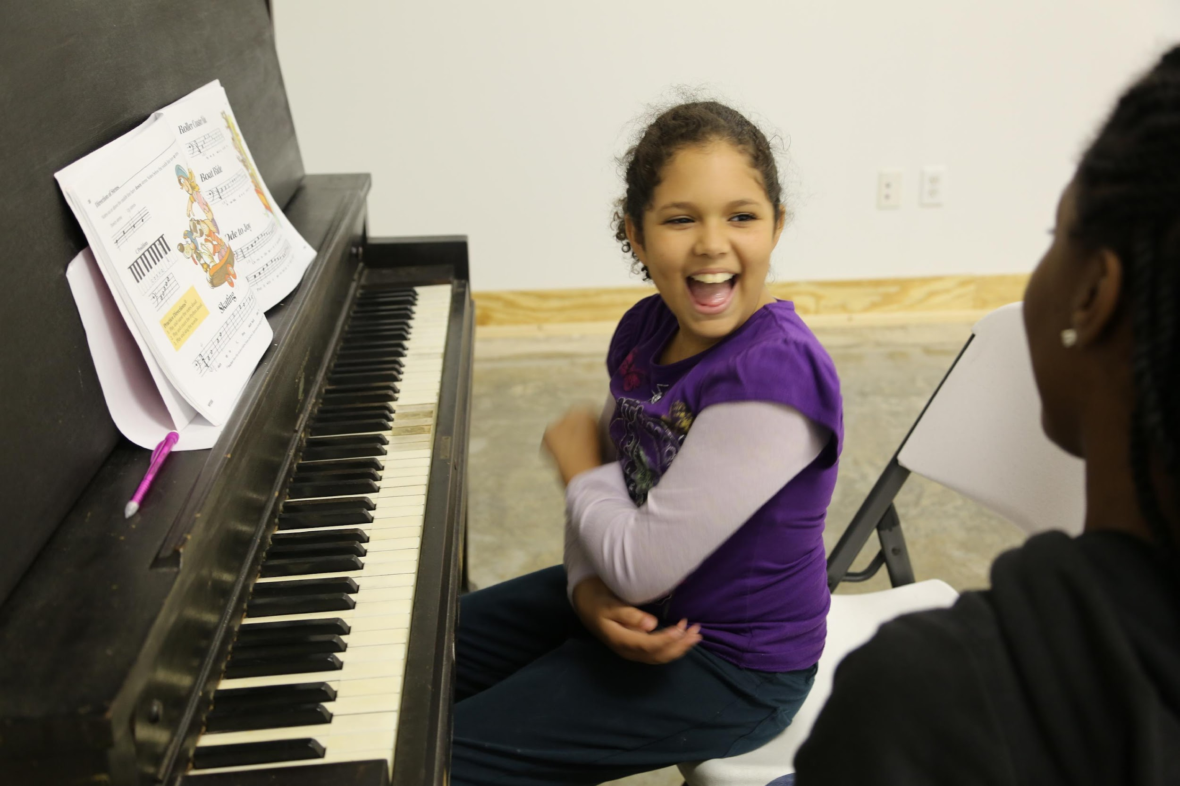
Social Recreation
Martial Arts
Swimming Lessons
Theater/Performing Arts
Sports League
Art Class
Music Lessons
Dance Class
… and many more!

Slide 10
CAMP
Camp may be utilized by an individual or family as an alternative resource for respite, daycare, day programming, or a social recreational experience.
Providers DO NOT have to be vendored, just willing to accept payment through an FMS
Community Services will review new camps to determine if can be vendored.
2

Slide 11
Minimum Criteria for Camp Services
2
The camp is determined to be appropriate by the planning team
The client’s ability to participate does not compromise his/her health and safety
The selected camp is vendored through SDRCs Community Services Department or willing to accept payment from a 3rd party FMS.
Other funding sources have been exhausted including camperships (scholarships), grants, and volunteers to provide inclusion support
Funding for transportation to/from the camp may be offered if needed and would be done through a TSR

Slide 12
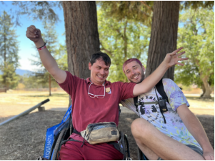
Camp
Summer Day Camp
School Break Camps
Overnight Camps
Day Camp:
Provides a creative experience in outdoor living for a limited period of hours per day and days per year.
Overnight Camp:
Provides a creative experience in outdoor living on a 24-hour per day basis for a limited period of time.

Slide 13
NON-MEDICAL THERAPIES
3
Non-Medical Therapies include but are not limited to specialized recreation such as art, music, and equine-assisted therapy.
Providers DO NOT have to be vendored, just willing to accept payment through an FMS
Community Services will review these providers’ credentials to determine if the program meets qualifications to provide the service.

Slide 14
Minimum Criteria for Non-Medical Therapies
3
The activity is recommended by the planning team.
The selected non-medical therapy provider is vendored through SDRCs Community Services Department or willing to accept payment from a 3rd party FMS.
Community Services staff will ensure that providers meet the standards required to provide non-medical therapeutic services. (limited exceptions)
Funding for transportation to/from the non-medical therapy may be offered if needed and would be done through a TSR

Slide 15
Non-Medical Therapies
Art, Music, Dance Therapy
Equine Therapy
Animal Assisted Therapy
Some Adaptive Programs
Music, Art, Dance Therapies:
Providers must have current registration with the American Music/Art/Dance Therapy Association.
Specialized Recreational Therapy:
Providers must be certified/credentialed in their field.

Slide 16
PROCESS FOR REQUESTING SERVICES

Slide 17
Client Responsibilities:
IDENTIFY a social recreation organization agency/provider for the social recreation activity they are requesting.
ASK the provider if they are willing to become vendored with SDRC or accept payment through SDRC's Financial Management Service (the FMS).
PROVIDE the bill payment procedure to the provider if the provider is willing to work with FMS.
GATHER information to provide to service coordinator.

Slide 18
Client Responsibilities continued
Share With Your Service Coordinator:
Name of social recreation agency/provider
Confirmation they are willing to accept payment through FMS
Type of activity (for example swimming, gymnastics, dance)
Activity setting (individual lessons or groups lessons)
How often will your child be attending the lesson/class
Cost of the lesson/class
How the activity will benefit yourself/your child
Date the activity will begin (in general, at least one month's notice is needed)

Slide 19
Service Coordinator Responsibilities
Once the SC receives information from the client, SC completes a social recreation screening/referral form and it is submitted to the PM for review (this includes any vendored provider for camps, social rec, and non-med therapies AND non-vendored providers for social rec activities).
FOR NON-VENDORED camps and non-medical therapies, the SC will submit the form as noted above to the PM and these requests will be reviewed by our Social Rec Team via the inbox.
Once approved or denied, SC will inform client.
If approved, SC and client complete an IPP amendment to add outcome and service to the IPP and the client signs an IPA summary sheet agreeing to the service. SC enters POS for services.
If approved, social recreation services are time-limited by definition and approved in no more than six months increments.

Slide 20
Service Coordinator Responsibilities continued
After activity ends, a new request may be submitted to the social recreation team to be reviewed/re-reviewed and approved for a new activity or to continue the current activity. It is also the responsibility of client to contact their service coordinator when services are ending to discuss continuing the same activity or switching to a different activity.
Typically, SDRC is only able to fund one social recreation service category at a time (social rec, non-medical therapy, camp), though it is possible to have more than one of each type of service. This is a planning team discussion/decision, and it should be clear that these services are not duplicative.

Slide 21
FMS Information for Potential Providers
Community Interface Services (CIS) is the Financial Management Service (FMS) provider.
As a third-party bill payer, CIS makes payments to social and recreational activity providers for clients of San Diego Regional Center (SDRC).
CIS purchases goods and services in accordance with SDRC regulations as determined by the individual’s planning team and documented on the Social Rec/Camp Screening Tool.
Every provider/merchant/person the service or activity is to be purchased from must complete and return a payment agreement form and W-9 to CIS.
SDRC pays for activities and services in arrears. In general, CIS will process payments to providers once an invoice is received from the provider and funds have been received from SDRC.

Slide 22
FMS Information continued
Provider invoices must include the following information:
Participant name
Exact cost of the activity or service purchased (cannot exceed authorization)
Date(s) of service and frequency
Name of the provider, merchant, or person the item is to be purchased from (must match the W-9)
Description of the service or activity with details as needed
If a provider/merchant/person is offering social and recreational services to multiple SDRC clients, they may choose to become vendored with SDRC and be paid by them directly.

Slide 23
FMS Payment Options and Timelines
Payment can be processed after services are authorized, a provider agreement form is completed, a W-9 and invoice are received (note: invoice cannot exceed authorization), and funds are available.

Slide 24
SC Step by Step Guide to Social Rec

Slide 25
Review Process
Complete Screening Tool via THEREFORE with the family/client upon initial request (a separate form is needed for each request)
Verify that selected services meet SDRC POS Guidelines/Standards
Verify the agency/company will accept FMS payment, if applicable
Submit Screening Tool to Program Manager for Review
SC Duties
Review and Approve/Deny Screening Tool Request in THEREFORE
If non-vendored camp or non-vendored non-medical Therapy, submit screening tool to Soc/Rec review team via THEREFORE workflow
PM Duties
Meets weekly to review submitted requests
If deferred/denied:
due to lack of information; will send screening tool back to SC and provide feedback
due to service not meeting POS standards; will send signed screening tool back to SC w/denial explanation in THEREFORE notes
When approved, signed screening tool will be automatically updated in THEREFORE and sent back to SC.
Review Team Duties

Slide 26
Communication w/ the Planning Team
All service dates should be discussed with the family, provider, and SDRC before the screening tool is submitted.
Non-Vendored Services
Once a request has been approved for a non-vendored service, SC should reach out to the client/family AND CIS to inform them of the decision.
Vendored Services
Once a request has been approved for a vendored service, SC should reach out to client/family AND vendor to inform them of the decision.
It is important to communicate a clear start date with all parties involved as soon as we receive approval. Providers (both vendored and CIS) will not see the client information in their vendor portal until there is an active authorization in SANDIS.

Slide 27
Social Rec Screening Tool
The Screening Tool is completed by the SC via Therefore
Ensure all sections are complete (use the drop down options)
Indicate if the individual is in SDP
Mark activity type (soc/rec, camp, non-med therapy)
Ensure service dates are accurate and do not exceed 6 months
Ensure cost is accurate
Ensure description of activity and who this activity will benefit the client is person-centered
PM will review. If there is missing information, PM will defer back to SC for updates. Once updated, SC will re-submit to PM for approval.
If activity is non-vendored camp/non-medical therapy: When PM approves, the screening tool is sent to the Social Recreation Inbox.
Please NOTE: Once the Screening Tool has been approved by the Social Recreation Review Team, the document will be sent back to the SC. At that point, the SC can notify the client/family, the vendor or FMS, and start the POS process. This entire process can take up to 4 to 6 weeks.

Slide 28
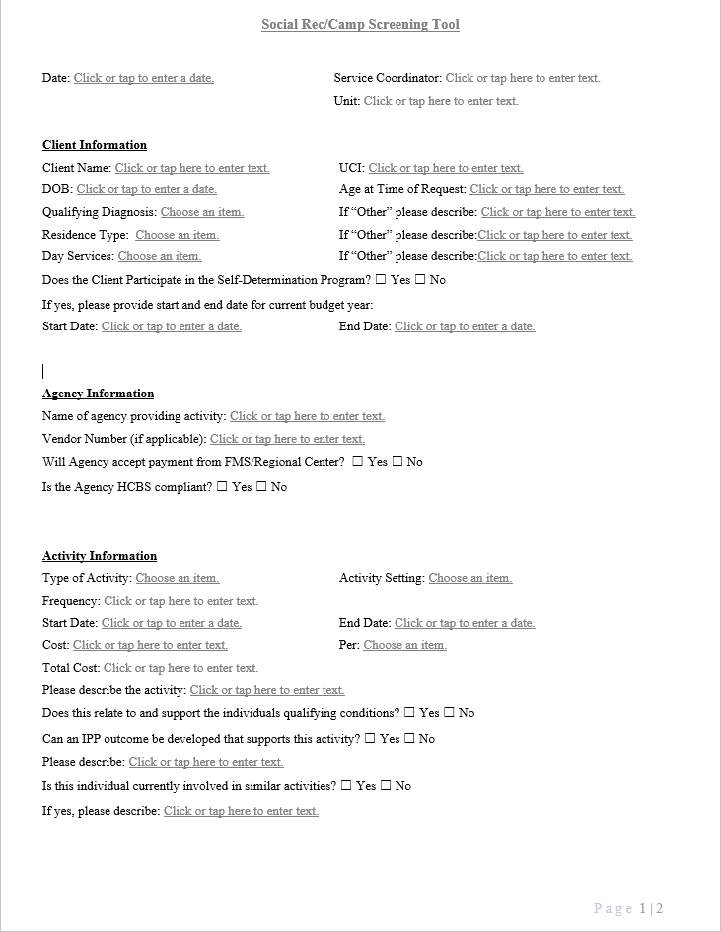
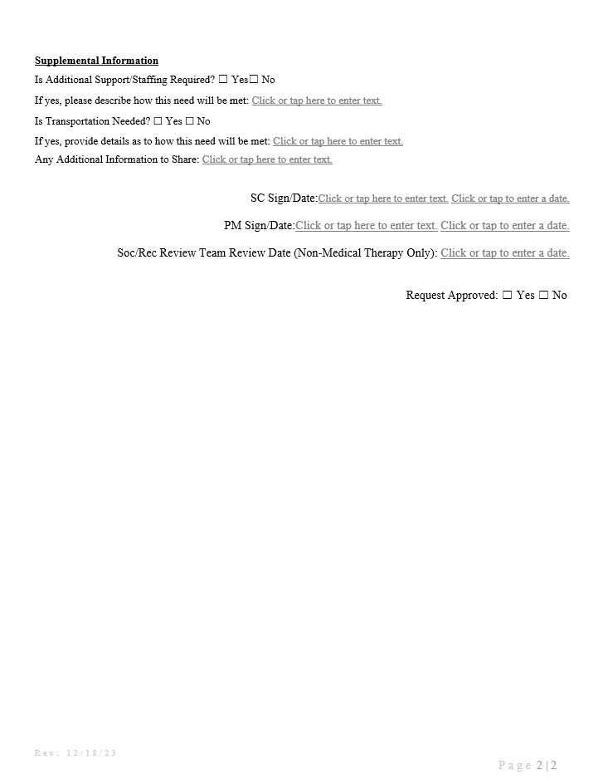

Slide 29
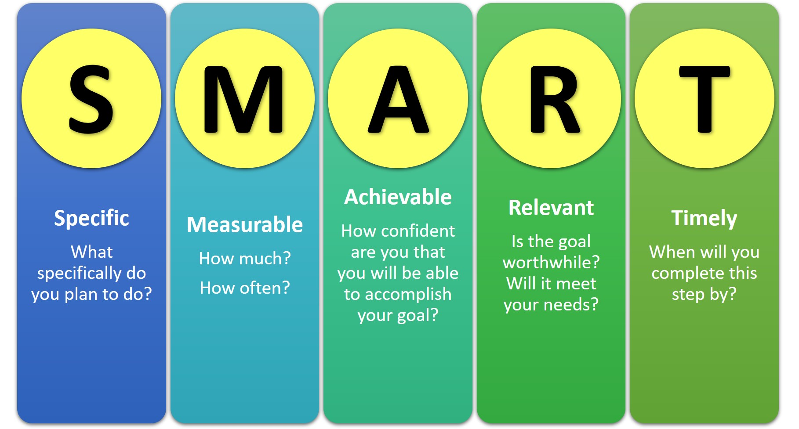
Request Approved
Create IPP/IPA/IFSP to reflect outcome, and the service.
IPP/IPA/IFSP signed and approved
Enter appropriate POS
Screening tool will determine POS info
SC Duties

Slide 30
POS Process - Vendored Services
SC will complete the POS using the vendor number and service code assigned
Service units and rate should align with the request
Timeframe of authorization should be no longer than 6 months (this can be re-assessed to continue after 6 months if planning team in agreement)
If there is a request for an activity to be longer than 6 months, please discuss with your PM and the Social Rec Review Team. Examples may include an activity that has an expected time frame for participation
Should not rollover, all POS’ will be split over the Fiscal Year
Fiscal justification should indicate the specifics of the request (3 sessions/month for 4 months; or 1 week camp at set rate of $/week, etc)
Ex. - $175/session x 3 session = $525 x 4 months = $2100
Regular justification should include
benefit related to the disability
IPP/IFSP outcome
‘Review Team approved on (date)’
Email a copy of the approved screening tool to the PM when the POS is submitted for review

Slide 31
All social recreational activities, camps, and non-medical therapies will have a subcode of Social Recreation Activity-SRA (with a variable rate 1.00).
**Please ignore all other subcodes .. we are only using SRA subcodes. Community Services is working on having the other subcodes deleted.

Slide 32
POS - Non Vendored services via Fiscal Management Service (FMS)/Third Party Payee
ONCE approval is received:
SC will need to enter 2 POS requests:
First POS: FMS monthly fee:
Select the appropriate FMS, Service Code 490 SRA (fee)
Rate is $50/month and you only need to enter 1 under service units.
One time service (PLEASE DO NOT CROSS THE 490 POS OVER THE FISCAL YEAR. We want this POS to match the actual services 459 POS.
Justification should state ‘monthly FMS fee for payment of [activity] with [provider], starting [date] and ending [date].’

Slide 33
POS Non-Vendored Services via FMS cont.
Second POS: Direct Service/Activity:
Select the appropriate FMS vendor
Service Code 459
Subcode will be Social Recreation Activity (SRA, SRAC, SRAN)
Variable rate (1.00)
Enter the exact cost of the activity
Timeframe of authorization should be no longer than 6 months unless approved by the Review Team (can be re-assessed to continue after 6 months if planning team in agreement).
Should not rollover
(PLEASE DO NOT CROSS THE 459 POS OVER THE FISCAL YEAR. We want this POS to match the actual services 490 SRA POS (fee).

Slide 34
POS Non-Vendored Services via FMS cont.
Second POS Service/Activity continued:
Fiscal justification should indicate the specifics of the request
Ex: 3 sessions/month for 4 months; or 1 week camp at set rate of $/week, etc)
Name of the provider of the service
Dates of Service
Ex. - $175/session x 3 session = $525 x 4 months = $2100
One time service
Regular justification should include:
benefit related to the disability
IPP/IFSP outcome
Approval date
Email a copy of the approved screening form to the PM when the POS is submitted for review.

Slide 35
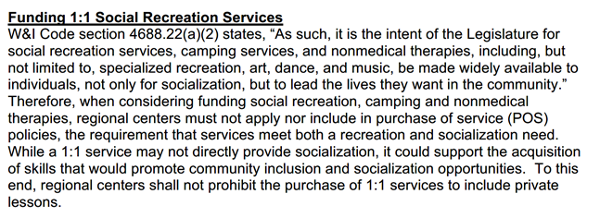
1:1 Supports for Soc/Rec, CAMP and Non-Med Therapies
SDRC may fund 1:1 supports during soc/rec, CAMP and non-med therapy activities. In order to determine the need for 1:1 supports, the request for an aide should typically be initiated by the vendor or non-vendor provider. With meaningful community integration the primary goal of all social recreational services, the decision to fund for 1:1 supports will be made as a planning team to determine the least restrictive, most appropriate level of support necessary for the client to access their social rec program.

Slide 36
Funding Equipment
W&I Code section 4688.22(a)(4) states, “It is further the intent of the Legislature for regional centers to prioritize access to those services, not only by referring consumers and their families to existing opportunities for social recreation services and camping services, but also by funding those services directly along with the supports they may need to access them, increasing the availability of vendors, and expediting vendorizations accordingly.”
SDRC may consider the purchase of equipment to support a client’s participation in a social rec activity. This is a planning team discussion. The planning team should exhaust all available resources for this equipment before purchasing (i.e. - rentals, scholarships, donations, etc.)
If the program is able to provide the equipment and can add that cost into the total POS cost, then the POS should reflect those added costs for equipment in the total cost.
If the equipment needs to be purchased separately, a new POS will be entered
Subcode SRAEQ will be used for equipment purchases. Both the 459 and 490 POS will use the same subcode. (see next slide for examples)
Planning team should determine where the equipment will be purchased from and share this information with CIS.

Slide 37
1:1 Supports for Soc/Rec, CAMP and Non-Med Therapies, continued
The request for 1:1 support must be indicated on the Soc/Rec Screening Tool with a brief description of the need.

Slide 38
Transportation is now available for all soc/rec, camps and non-med therapies and a TSR is required (**PDS):
Options include voucher options (participant directed service), possible bus pass, MTS Access
Contract services are most likely not an appropriate option as these vendors typically have scheduled routes to specific sites/locations
All transportation requests should be described on the Soc/Rec Screening Tool under Supplemental Info (location of soc/rec activity, vendor info if provider is vendored, days per week, any info to support TSR).

Slide 39
Request Denied
Inform SC the reason deferred/denied:
Request not in line with POS guidelines (denied)
Need additional information (deferred)
Review Team Duties
If denied for reason #1 above, inform client/family and complete the Good Faith Letter/NOA process in collaboration with your program manager.
If deferred for reason #2 above, obtain the additional information requested and resubmit via THEREFORE WORKFLOW
SC Duties

Slide 40
Multiple Concurrent Requests
Funding for more than one social rec / camp / non-medical therapy at a time (overlapping service dates) can occur under certain circumstances. The Planning Team must determine it is appropriate and would not be considered a duplication of service.
For vendored services with overlapping service codes, the POS Justification should clearly state that this is “Planning Team decision” and “not a duplication of service”. A corresponding T19 outlining how the Planning Team reached this decision should be entered.
For multiple activities in the same month using the 459 Service Code, the above justifications still apply, but the POS should be entered as 1 POS with a breakdown of all expenses in the justification. (example on next slide)
Provider name should be at the beginning of each line in the fiscal justification.
490 FMS SRA POS should be inclusive of multiple activities.

Slide 41
Prepayments!
SDRC is finalizing this process, and Business Services has confirmed with DDS that their proposed method will meet audit merit.
In order for a business to be paid in advance, SDRC’s Community Services Team will need to procure a copy of that business’s payment schedule from their website.

Slide 42
Process for New Vendorization Requests
Please connect potential vendor to SDRC’s Community Services Department.
Community Services gets information from potential vendor to determine appropriate service code and requirements.
40 requests come in a month.
Will communicate as programs are vendored or if program does not qualify on the spreadsheet.

Slide 43
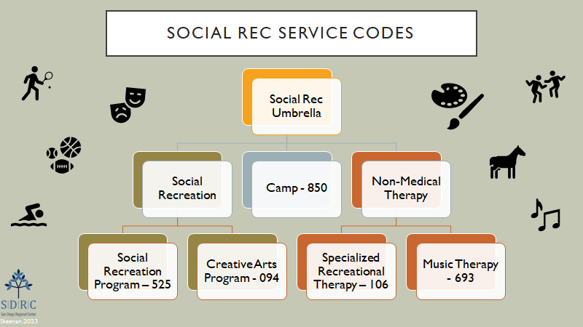

Slide 45
Participant Directed Social Recreation, Non-Medical Therapy and Camp
459 SRA for non-vendored Social Recreation Activities and accompanying FMS fee service code and subcode 490 SRA
459 SRAN for non-vendored Non-Medical Therapy and accompanying FMS fee service code and subcode 490 SRAN
459 SRAC for non-vendored Camp and accompanying FMS fee service code and subcode 490 SRAC
459 SRAEQ for Equipment Purchase and accompanying FMS fee service code and subcode 490 SRAEQ

Slide 46
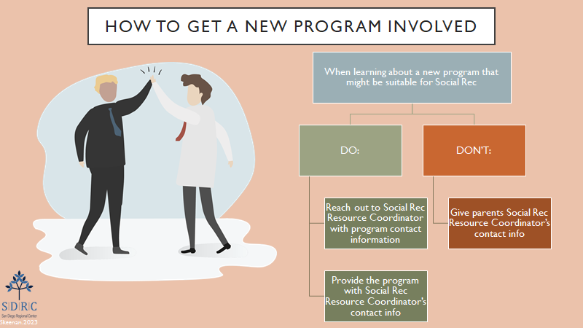

Slide 47
Self Determination Program
Requests should follow the same process as Traditional Services including review by the social rec review team as needed.
Start process of requests early on in initial planning (When you receive a Person Centered Plan or have a request to build a SDP budget) to streamline process of enrollment.
Vendors and Non-Vendors would be paid by the individual’s self-determination FMS
Usual and customary rates for services that would be funded by an FMS under traditional services
Median/set rates for those services that should/would be vendored by SDRC (consultation with community services may be needed to determine appropriate rates)
HCBS applies to all services
Social/ rec team will need to evaluate some requests on case by case basis to take Self Determination into account
Generally speaking, non-vendored social rec/ camps/ and non-medical funded into the Individual Budget should be reflected as such in the Spending Plan.
If approved by your PM or Social Rec Review Team, DO NOT enter a Traditional POS please… see next slide!

Slide 48
Self Determination Program
Funding Social/Rec in SDP
Initial or annual Individual Budget would include service as one time/ temporary service.
Budget Adjustment would be made for existing SDP budgets
Funding of Social/ Rec service & FMS fees would be included in budget (Non-vendored social rec requests)
For ongoing participants, updated spending plan, POS ‘work with’ and IPA required
Schedule a Calendly session with Participant Choice Specialist for support in this area or email SDP@SDRC.org
SDP participants can also use their SDP budget funds for social rec services without requesting additional funds for social rec from SDRC. EX: Client uses their respite hour funds for karate and tennis lessons in their spending plan.

Slide 49
QUESTIONS?

